Slide 1
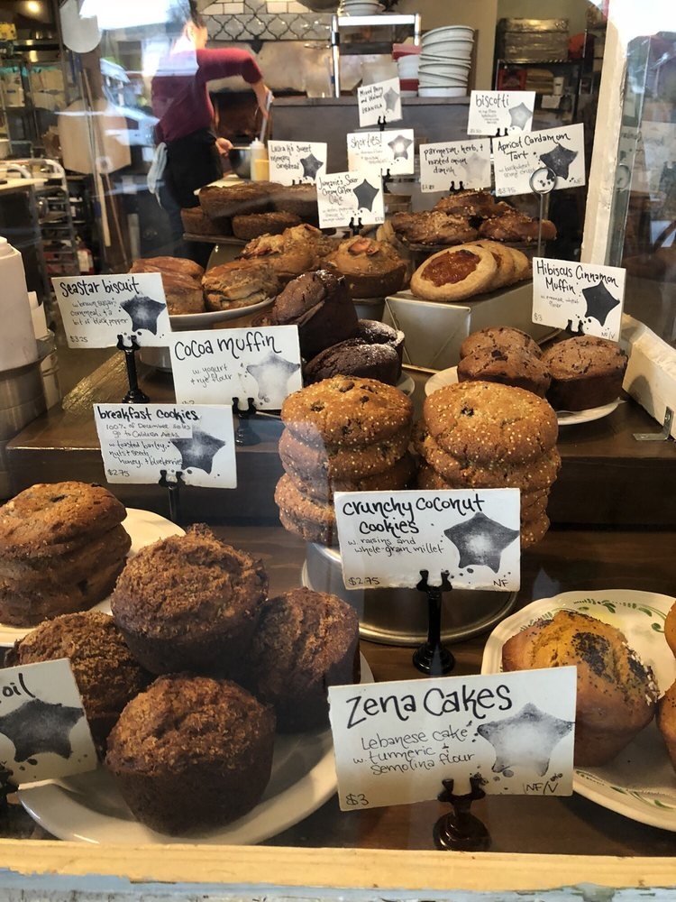
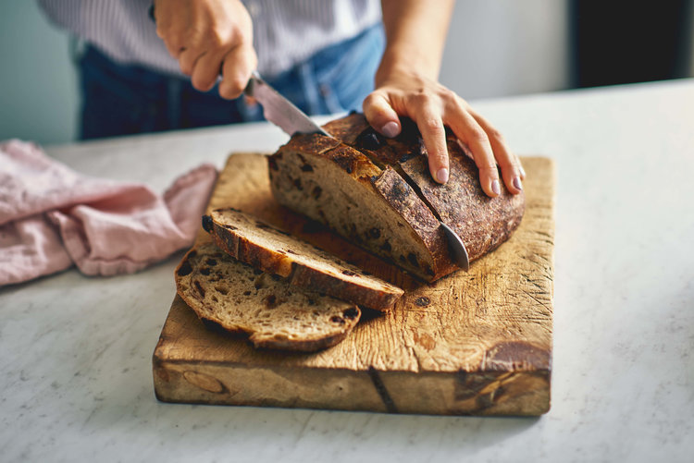
Bakers Panel
Rob Salvino, Damsel & Hopper Bakeshop
Mel Darbyshire, Grand Central Bakery
Annie Moss, Seastar Bakery
Cortney Morentin, Wyld Breads

Slide 2
What we’ll be covering today
The why and how of baking with regional, non-commodity flour
Sourcing
Recipe adapting
Relationship building
Consumer education

Slide 3
Why bake with regional, non-commodity flours?
Many of these flours have their own personalities
They can make your breads and pastries stand out
At Damsel & Hopper Bakeshop we offer three everyday sourdoughs--Turkey Red, Einkorn, and Sonora
Our customers love the variety. They may have a favorite, but they will try the others too.
Pastries? Light, flaky, moist, and delicious are all possible (need we mention more nutritious?)
We’re fans of einkorn flour from Bluebird Grain Farms and Sonora from Palouse Colony Farm

Slide 4
Why bake with regional, non-commodity flours?
Baking with them can feel like opening up a box of 64 Crayola crayons when all you’ve ever used before was a box of 8
Josh Grunig (formerly Standard Bakery and soon-to-be Zylbersteins’s)
We use Small’s white flour, Yecora Rojo, Trailblazer, Edison and others. We really came to love the flavor of the Edison flour from CairnSpring, but all of the flours are great to work with.

Slide 5
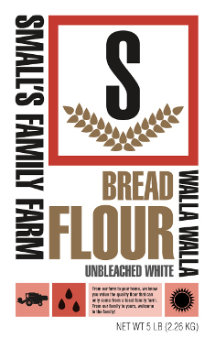
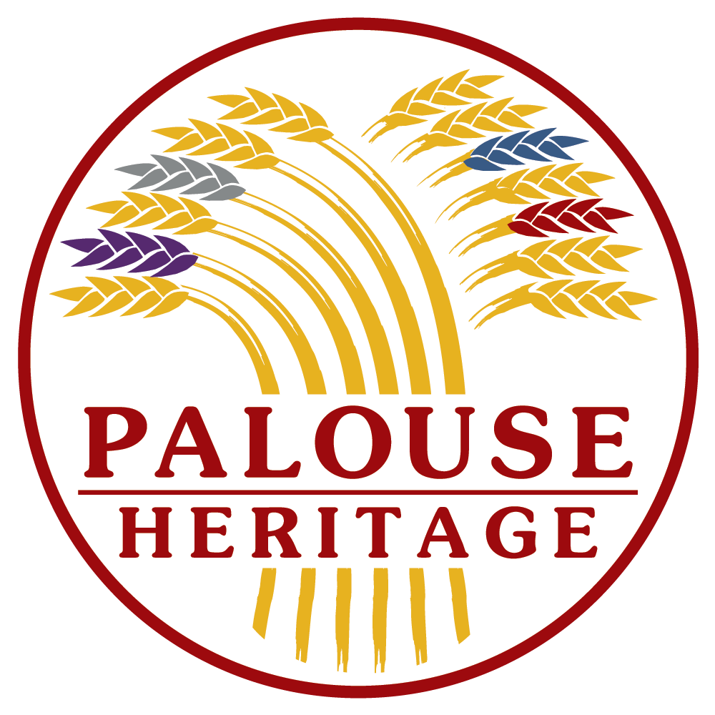
Why bake with regional, non-commodity flours?
The timing is great with lots of new suppliers!

Slide 6
Why bake with regional, non-commodity flours?
The timing is great!
The crop development work that WSU has been doing in its Mt. Vernon Research Station is beginning to reach farmers

Slide 7
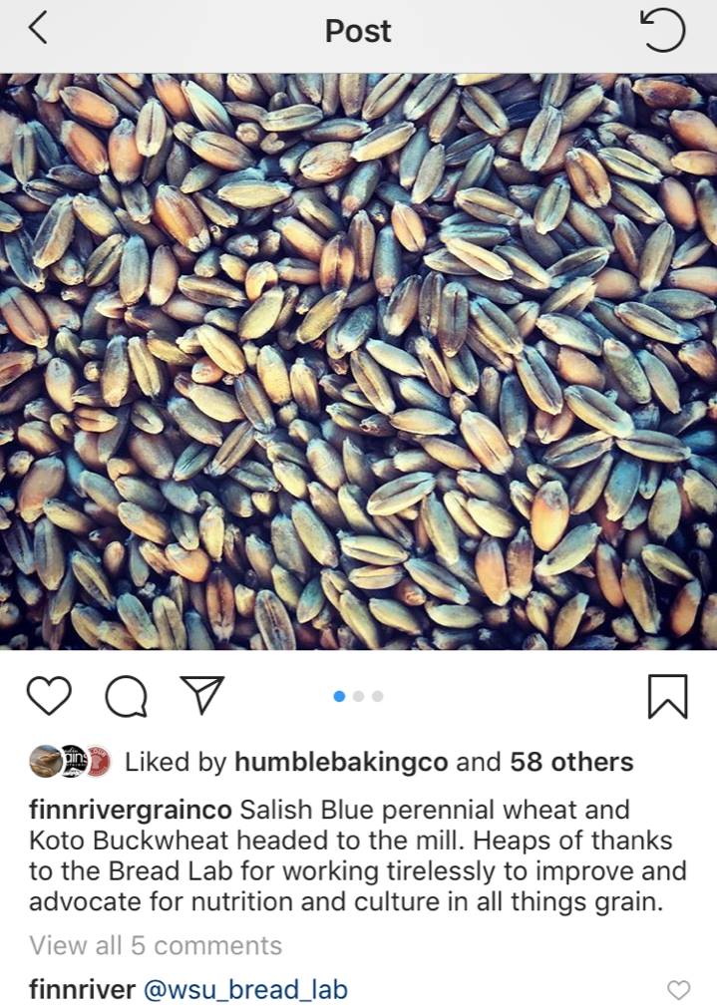
Finnriver Cider is growing grain!

Slide 8
Recipe adapting
Tatum Nolan from CairnSpring, Flour is not plug and play. There’s a learning curve to it.
The learning curve can be intimidating. It can be hard to find the time to break the code.
Be persistent. Commodity white flour is easy. Regional, non-commodity wheat flour? Not so much.
Take heart. It’s going to make you a better baker.

Slide 9
Recipe adapting
Think about the ingredient first
Sophie from Raven Breads in Bellingham
When I started my bakery I looked at what locally milled flour was available, and then I figured out what I could bake with it. I didn’t begin by thinking of what type of loaf to bake and then trying to make the flour fit it.

Slide 10
Recipe adapting
What to look for
Sensory
Flavor
Color
Texture
Performance
The strength and behavior of the gluten
Water absorption

Slide 11
Recipe adapting
Recipe for success
Time
Dedicated time is the best
Targets
Set some goals so your R&D stays on track
A good notebook

Slide 12
Consumer education
Our cardinal rule of messaging
‘Product’s gotta be good’
If it’s good then customers are going to want to know more about it
Our second rule—simple is understandable
K.I.S.S. for your staff, for your customers

Slide 13
Consumer education
Provide deeper engagement opportunities for those customers who want to know more—and many do

Slide 14
Sea Wolf baking classes

Slide 15
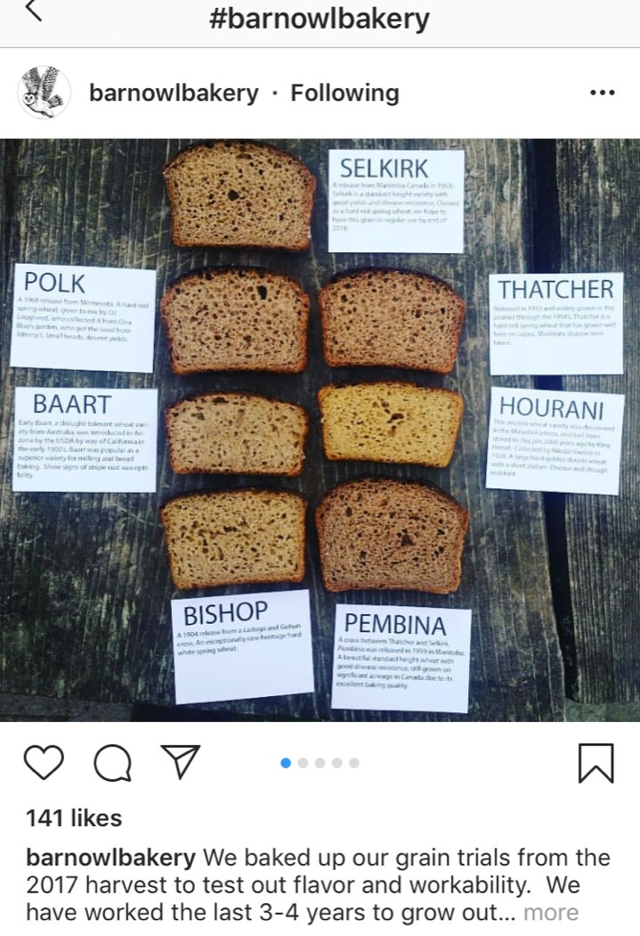
Barn Owl Bakery flour trials

Slide 16
Sourcing An admittedly incomplete list
Mills and direct-sourcing farms
CairnSpring Mills
Palouse Heritage
Fairhaven Organic Flour Mill
Camas Country Mill
Bluebird Grain Farms
Small’s Family Farm

Slide 17
Sourcing An admittedly incomplete list
Distributors
Glory Bee (Fairhaven, CairnSpring)
Merlino (Fairhaven, CairnSpring, Small’s Family Farm)
Evergreen United Food Hub (western WA)
Puget Sound Food Hub (western WA)

Slide 18
The number one tool to help you start or expand your use of regional, non-commodity flour in your bakery

